Slide 1
co2-Emission-Prediction

Slide 2
Objective
The primary objective of the project is to develop a model that can accurately predict CO2 emissions based on different engine features of cars.
The goal is to estimate the amount of CO2 a car will emit using the provided data.

Slide 3
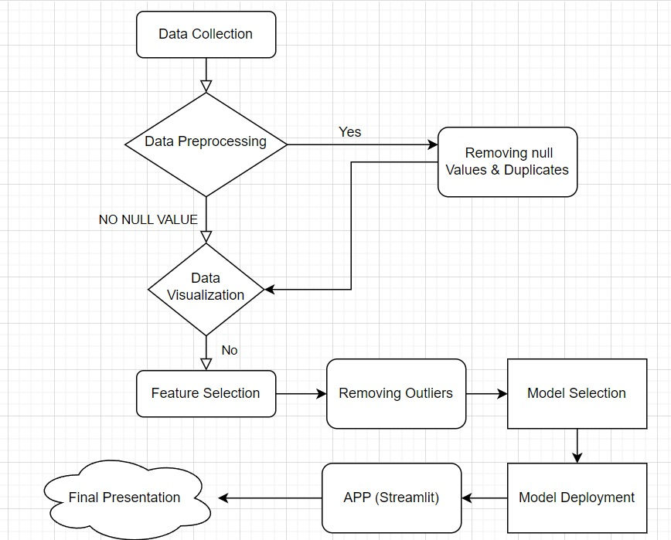
Flow chart of the project

Slide 4
Description of The Data:
It includes the following attributes:
Make: Car brand under study.
Model: Specific model of the car.
Vehicle_class: Car body type.
Engine_size: Size of the car engine in liters.
Cylinders: Number of cylinders.
Transmission: Type of transmission (e.g., automatic, manual).
Fuel_type: Type of fuel used by the car.
Fuel_consumption_city: City fuel consumption ratings in liters per 100 kilometers.
Fuel_consumption_hwy: Highway fuel consumption ratings in liters per 100 kilometers.
Fuel_consumption_comb(l/100km): Combined fuel consumption rating (city and highway) in L/100 km.
Fuel_consumption_comb(mpg): Combined fuel consumption rating in miles per gallon (mpg).
Co2_emissions: Tailpipe emissions of carbon dioxide for combined city and highway driving, in grams per kilometer.

Slide 5
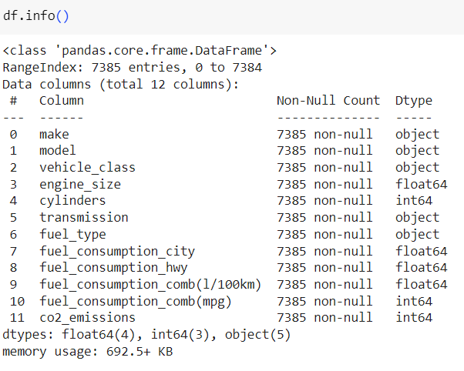

Slide 6
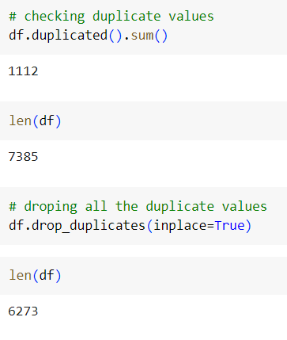
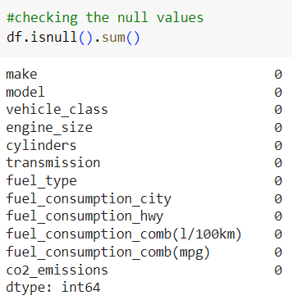
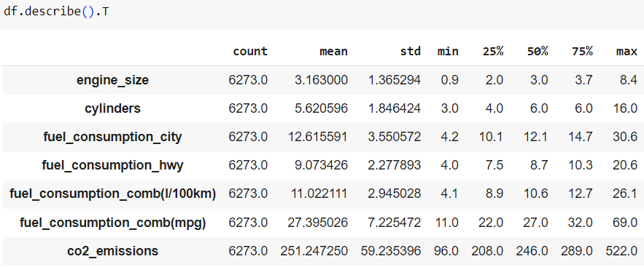

Slide 7
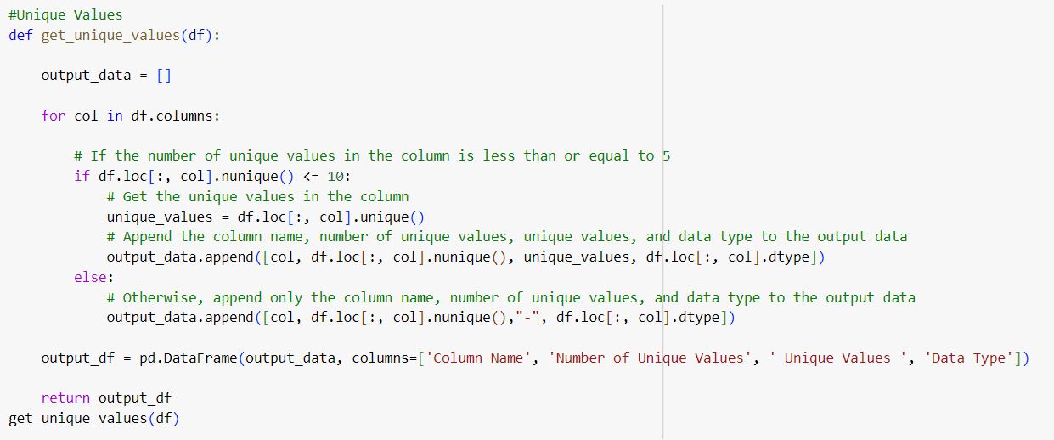
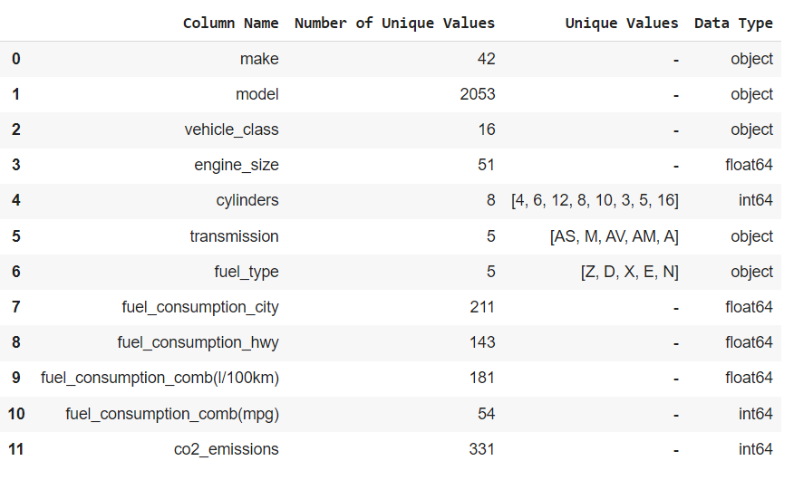

Slide 8

Unique Values

Slide 9
EDA

Slide 10
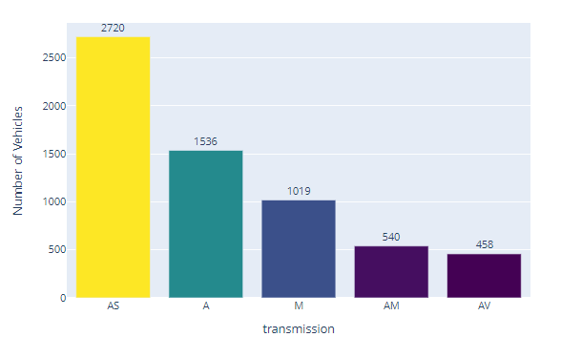
transmission

Slide 11
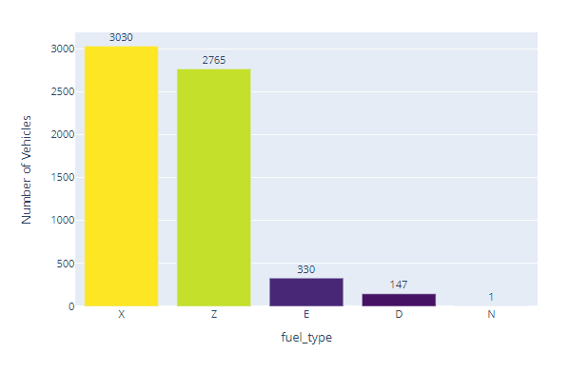
Fuel type

Slide 12
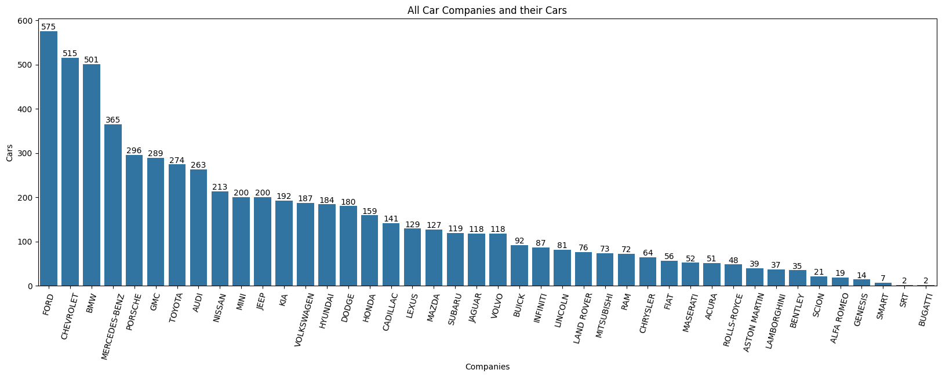
All Car Companies and their Cars

Slide 13
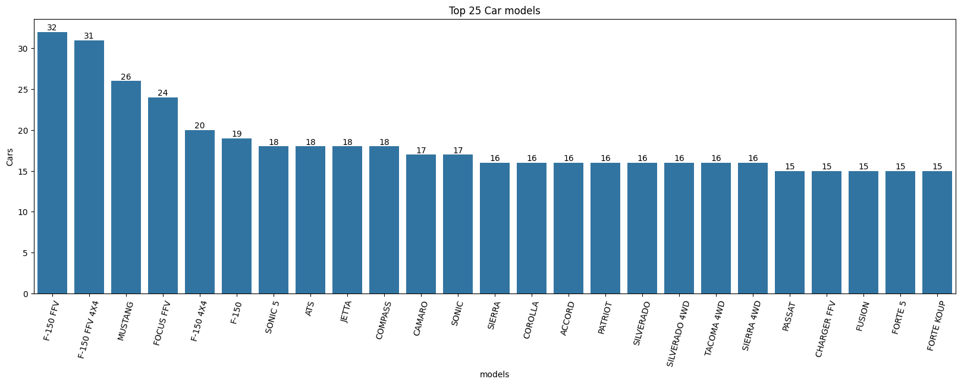
Top 25 Car models

Slide 14
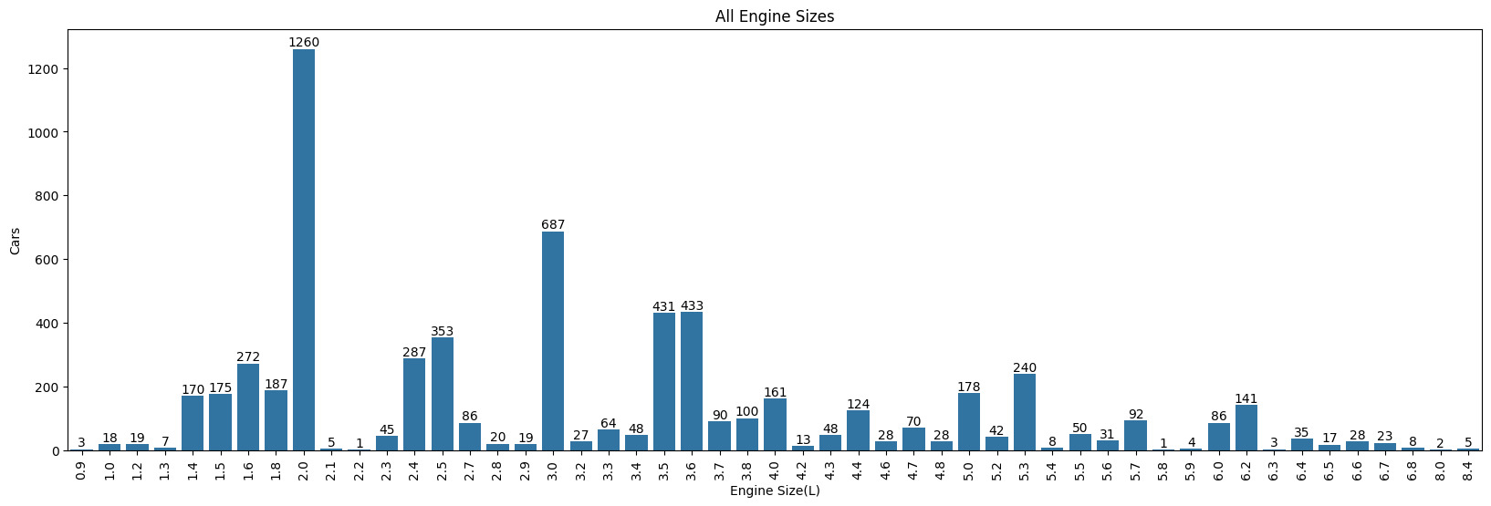
All Engine Sizes

Slide 15
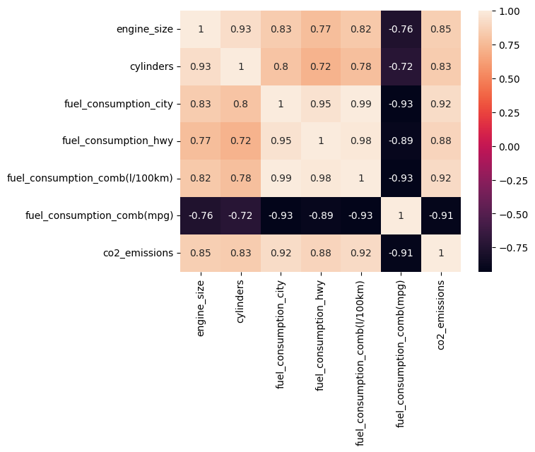
Heat Map

Slide 16
Machine Learning Model Building

Slide 17
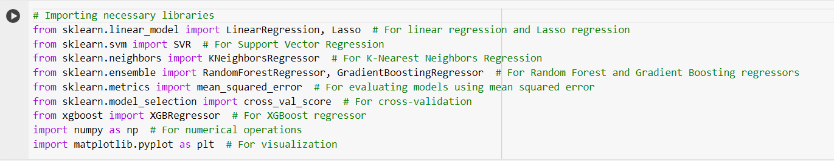
Importing Libraries :
In this step, we import all the necessary libraries required for our regression analysis.
These libraries include tools for data manipulation, model training, evaluation, and visualization.

Slide 18
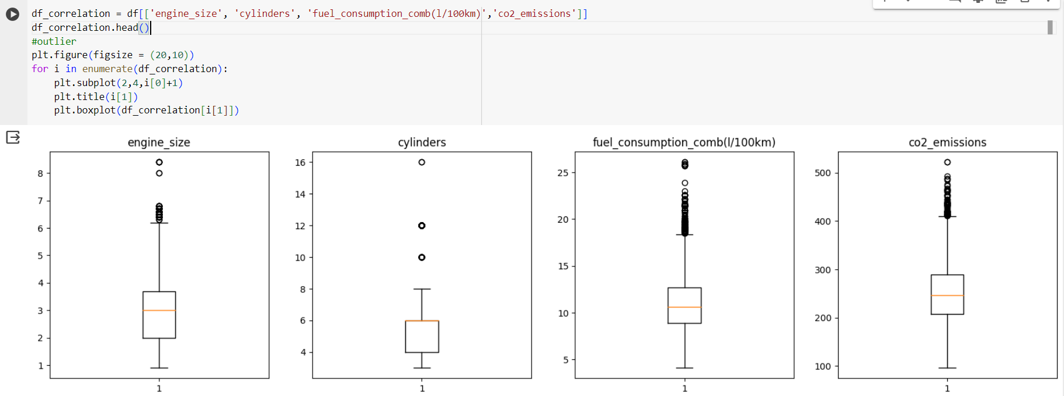
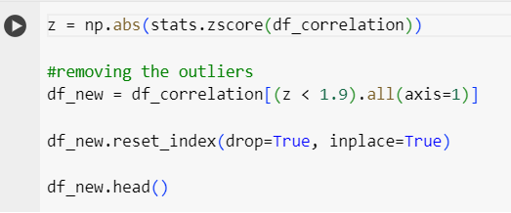
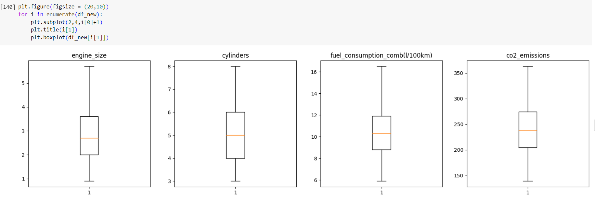
Removing outliers:

Slide 19
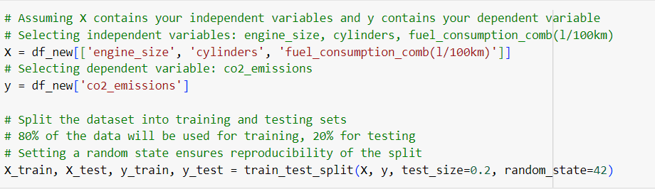
Data Preparation:
Features (X): Engine size, number of cylinders, and fuel consumption (per 100km).
Target (y): CO2 emissions.
Splitting Data: 80% for training, 20% for testing, ensuring reproducibility with a random state of 42.

Slide 20
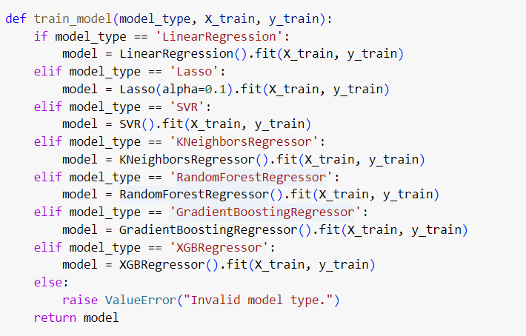
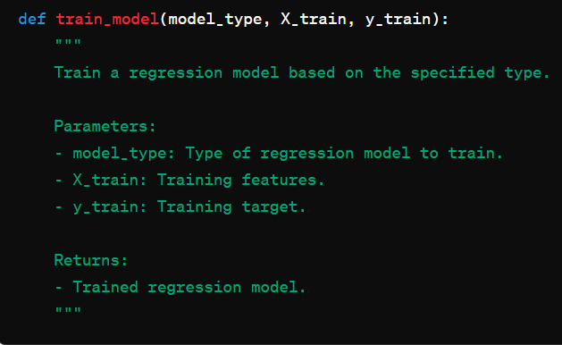
Define Function for Training Regression Models:
This step defines a function train_model to train regression models based on the specified model type.
The function takes the model type (model_type), training data (X_train and y_train), and returns the trained model.

Slide 21
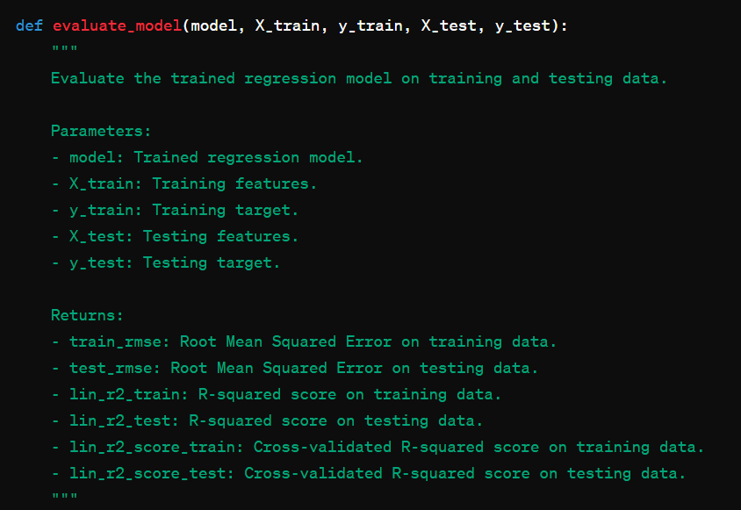
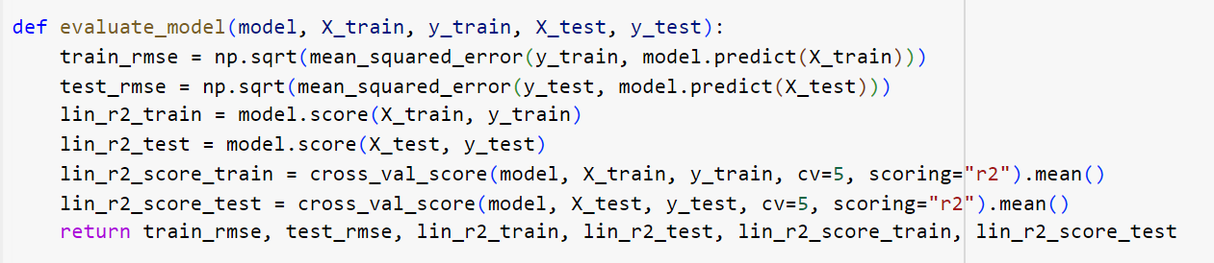
Define Function for Evaluating Regression Models:
This substep defines a function evaluate_model to evaluate the performance of trained regression models.
The function takes the trained model (model), training and testing data (X_train, y_train, X_test, y_test), and returns evaluation metrics such as RMSE and R-squared.

Slide 22
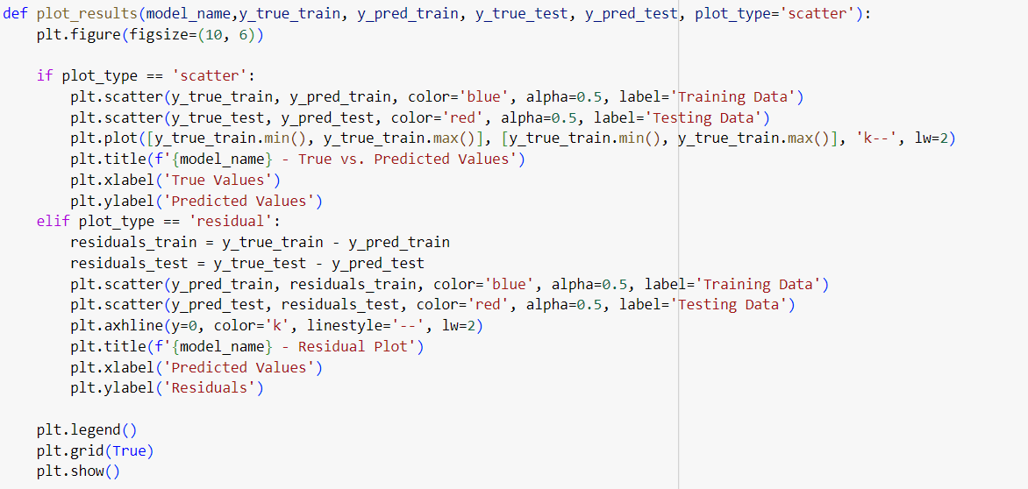
Define Function for Plotting Results:
We define a function plot_results to visualize the results of our regression models.
This function can plot scatter plots of true vs. predicted values or residual plots.

Slide 23
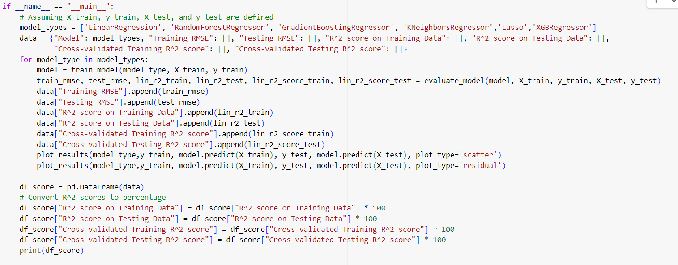
Main Script Execution
In the main part of the script, we train and evaluate multiple regression models, including Linear Regression, Lasso, SVR, KNeighborsRegressor, RandomForestRegressor, GradientBoostingRegressor, and XGBRegressor.
We iterate through each model type, train the model, evaluate its performance, print the results, and plot the true vs. predicted values and residual plots.

Slide 24
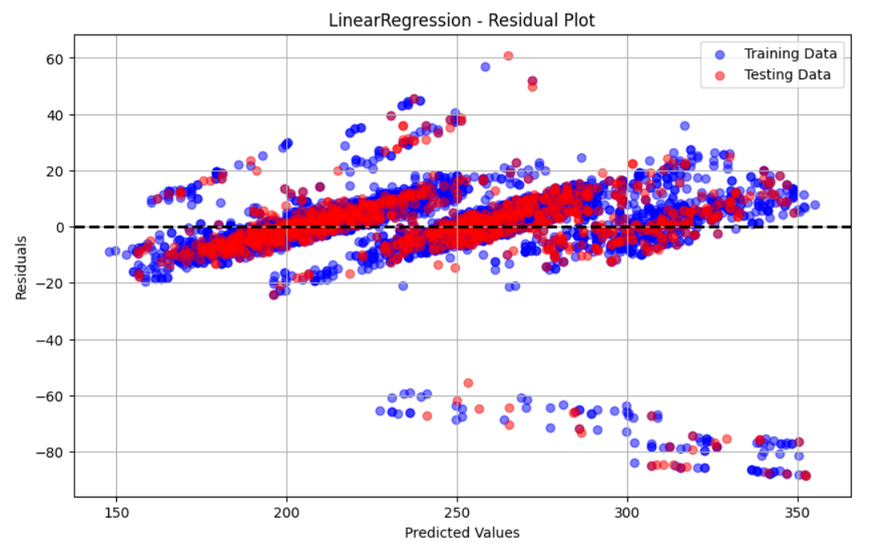
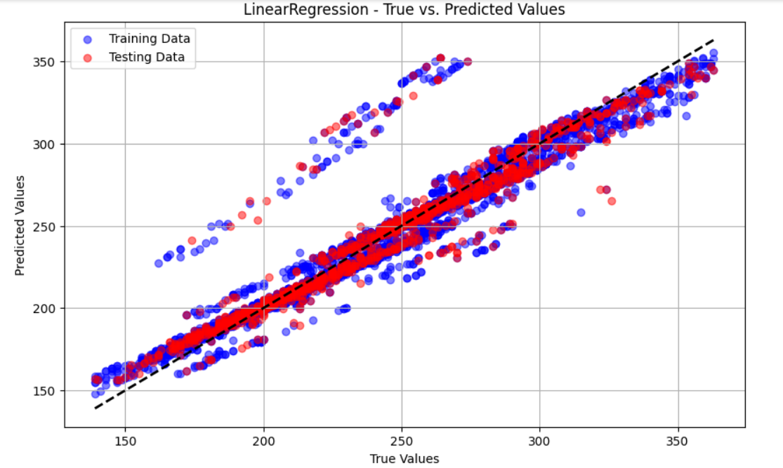
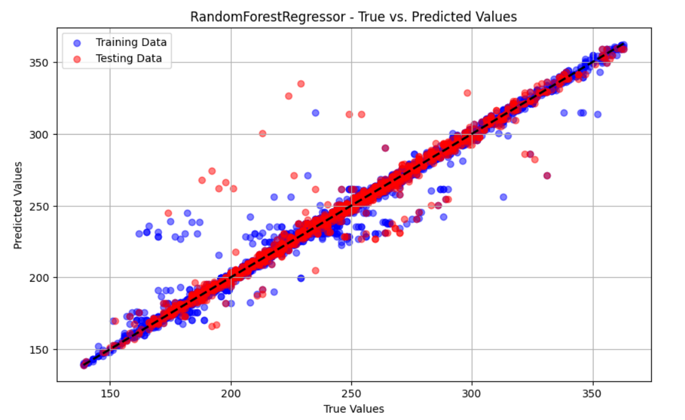
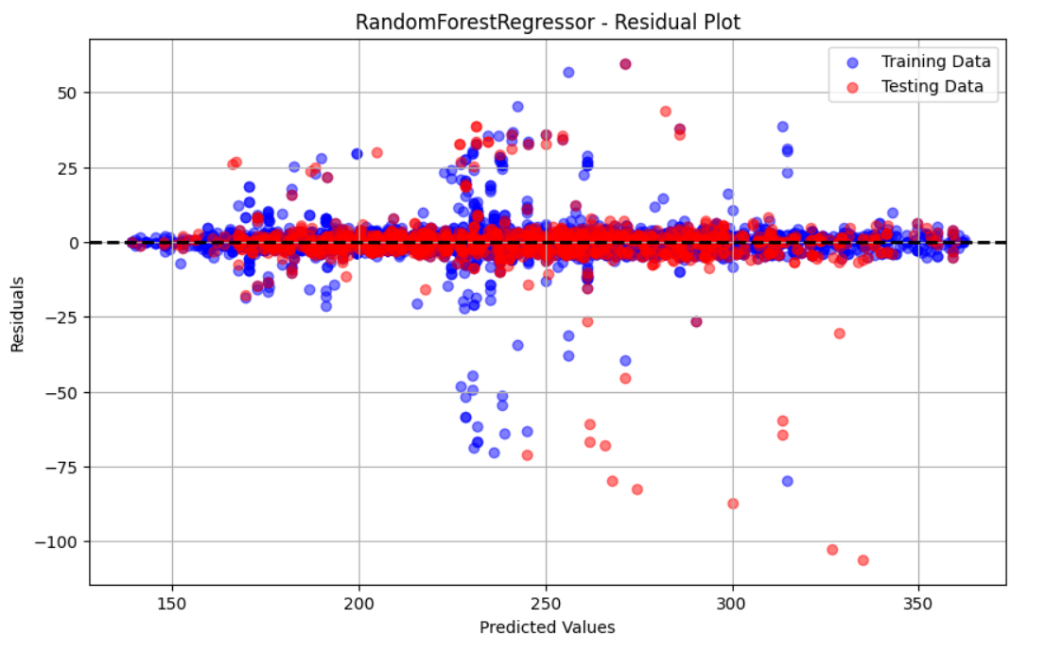
scatter plot vs residual Plot

Slide 25
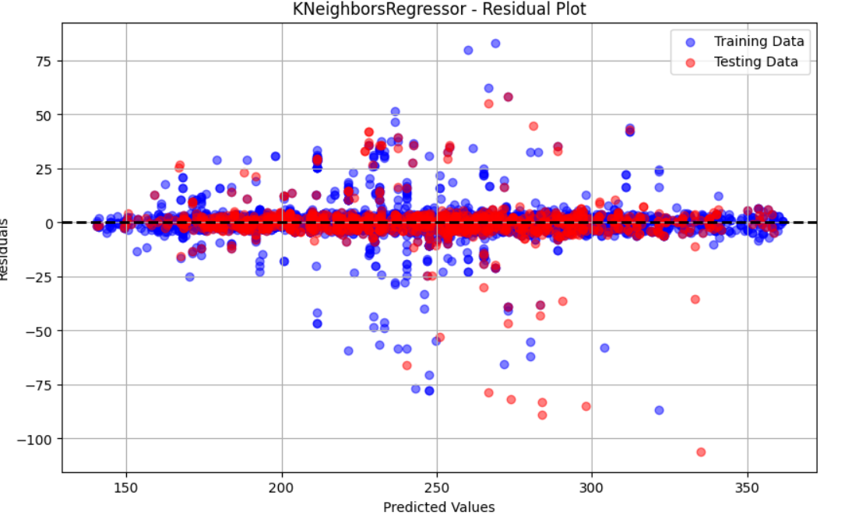
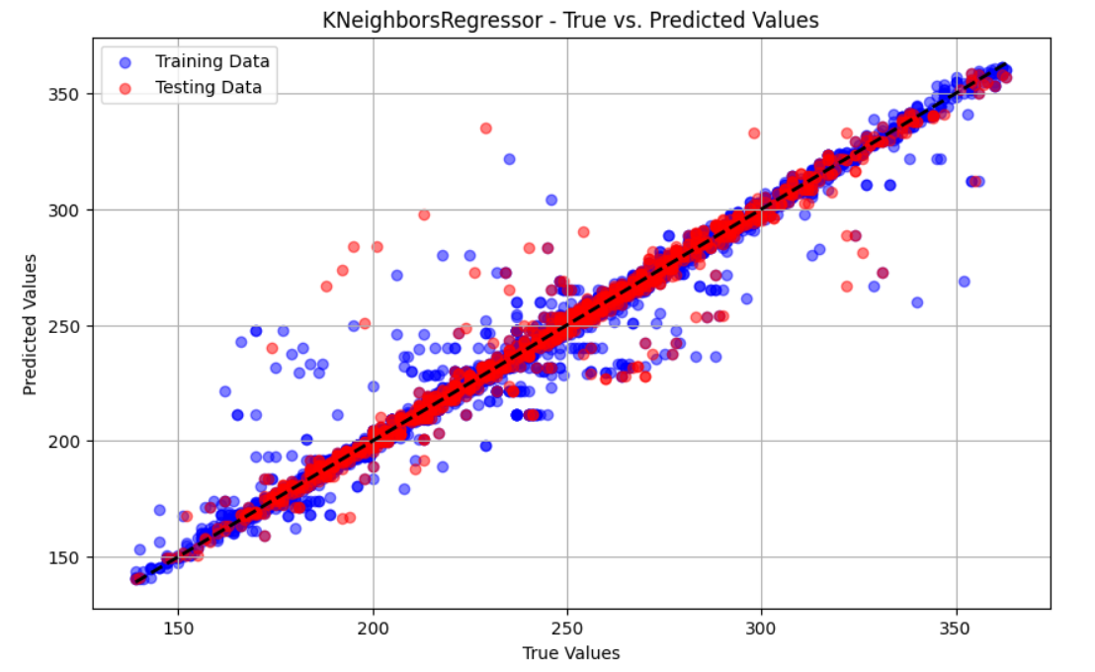
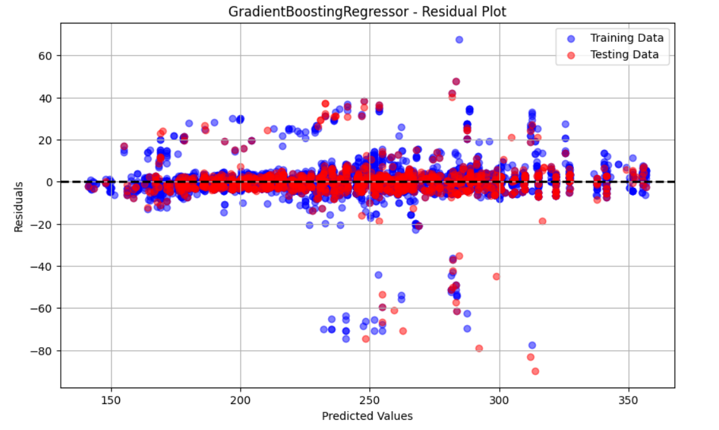
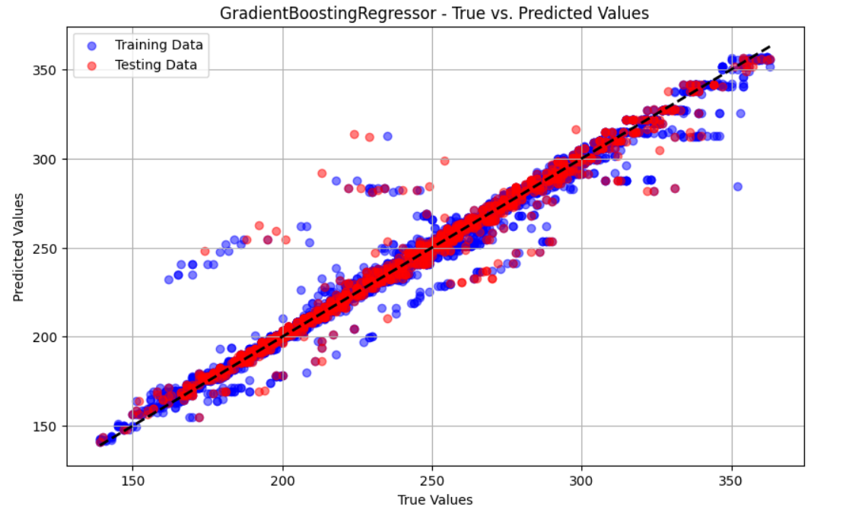
scatter plot vs residual Plot

Slide 26
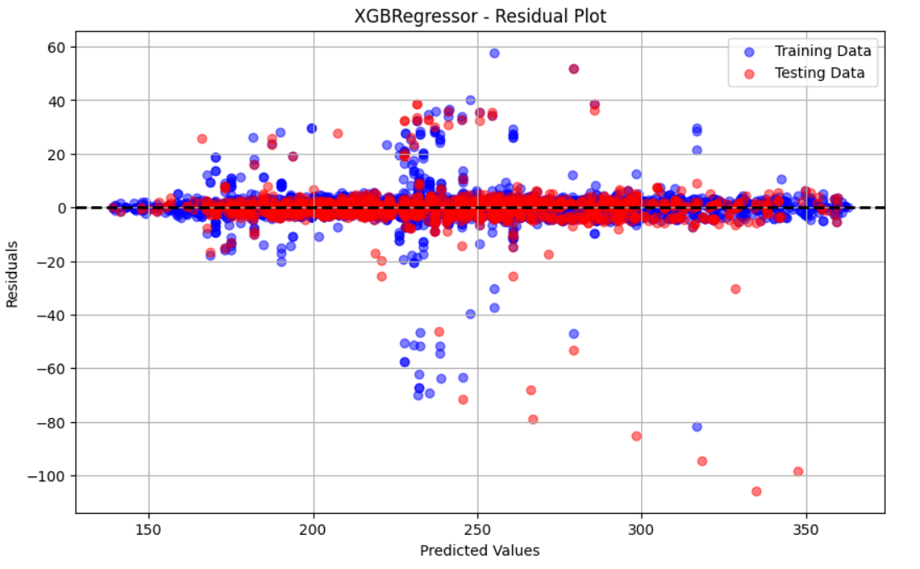
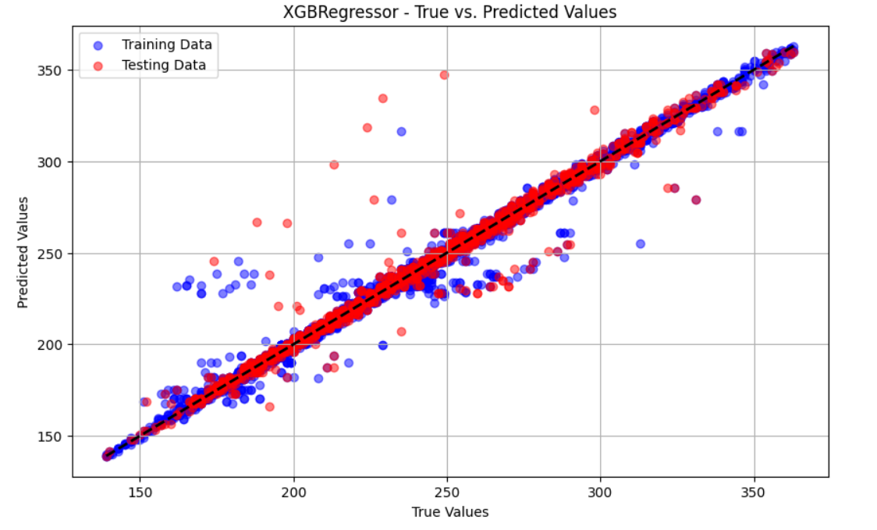
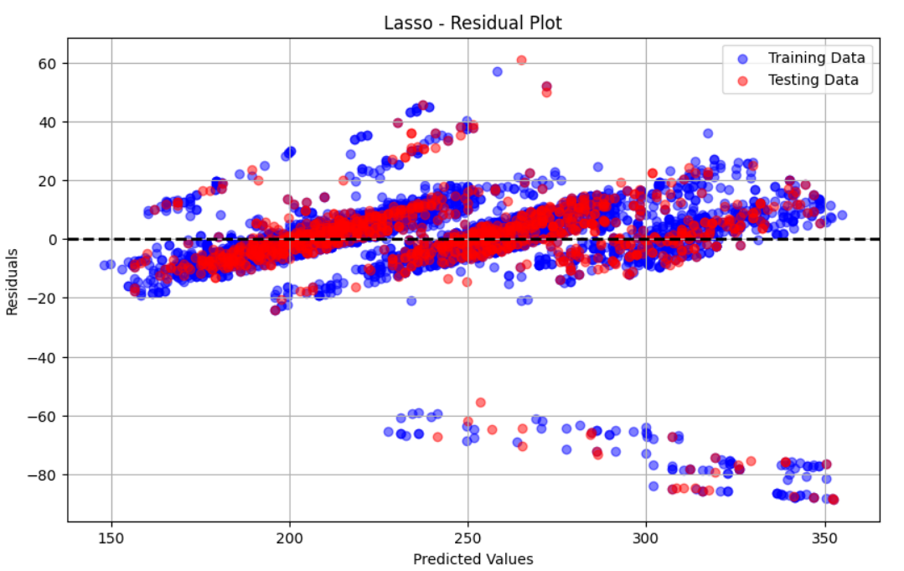
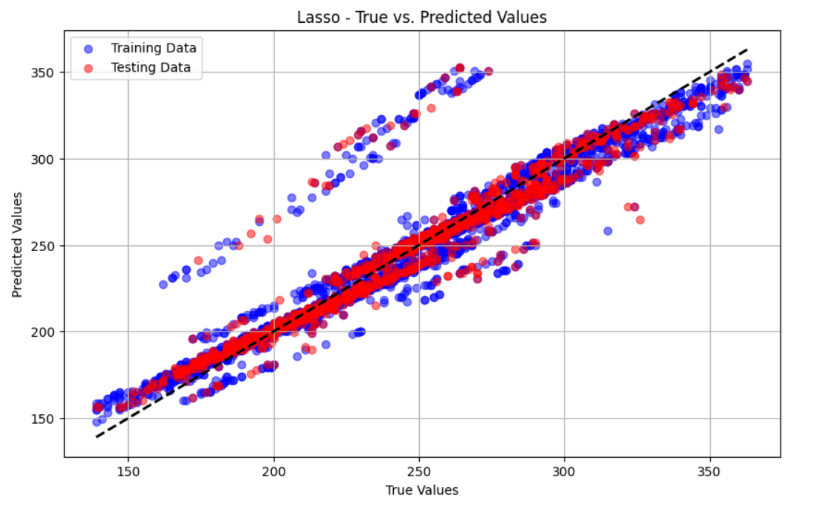
scatter plot vs residual Plot

Slide 27
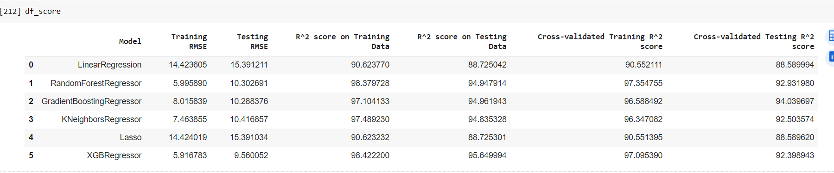
Model Evaluation Score

Slide 28
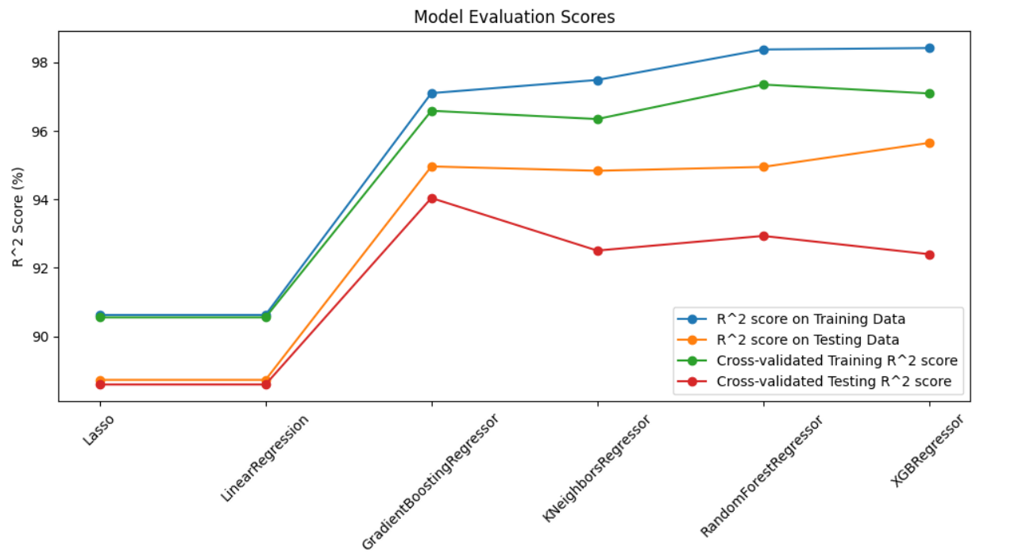
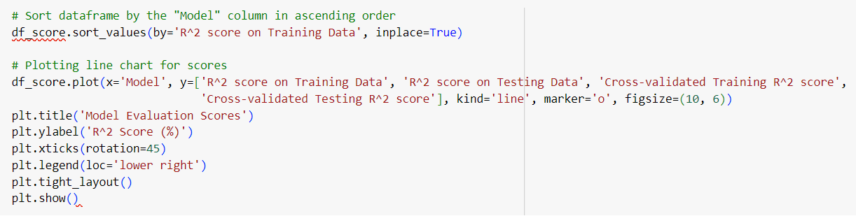
Model Evaluation Plot

Slide 29
Model Deployment

Slide 30
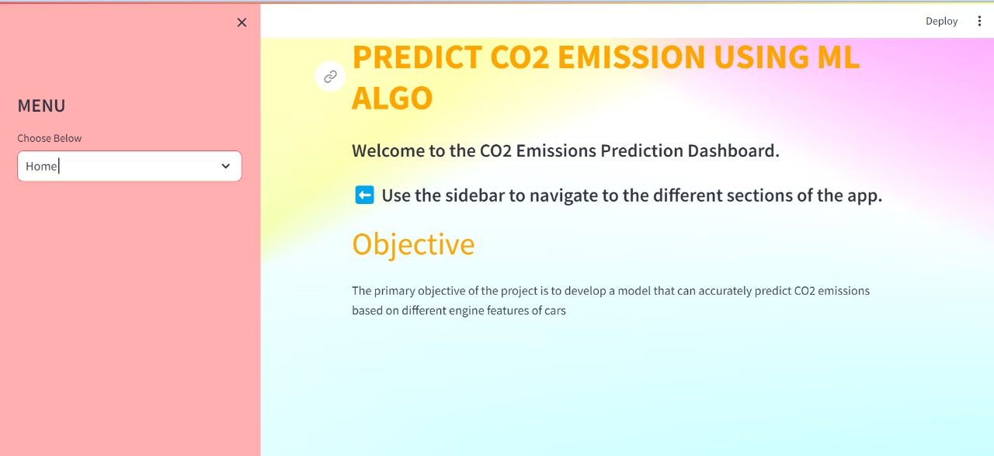
Home Page

Slide 31
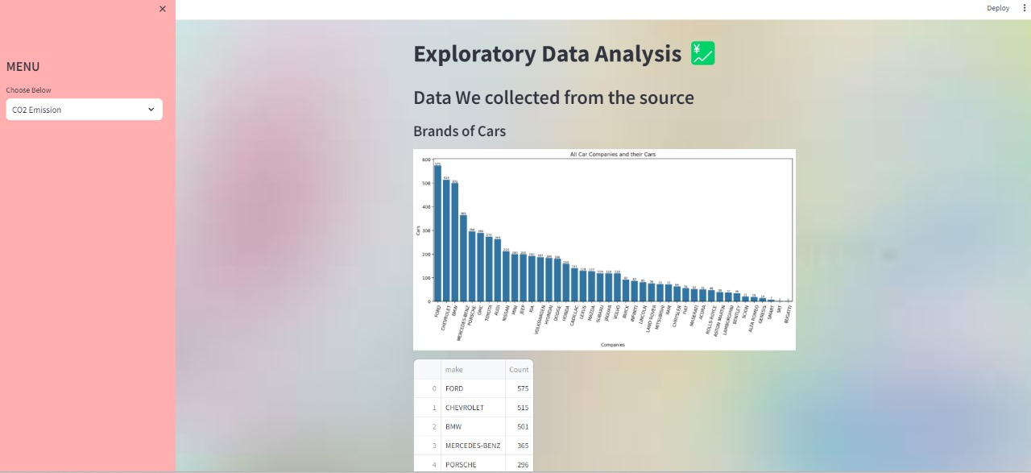
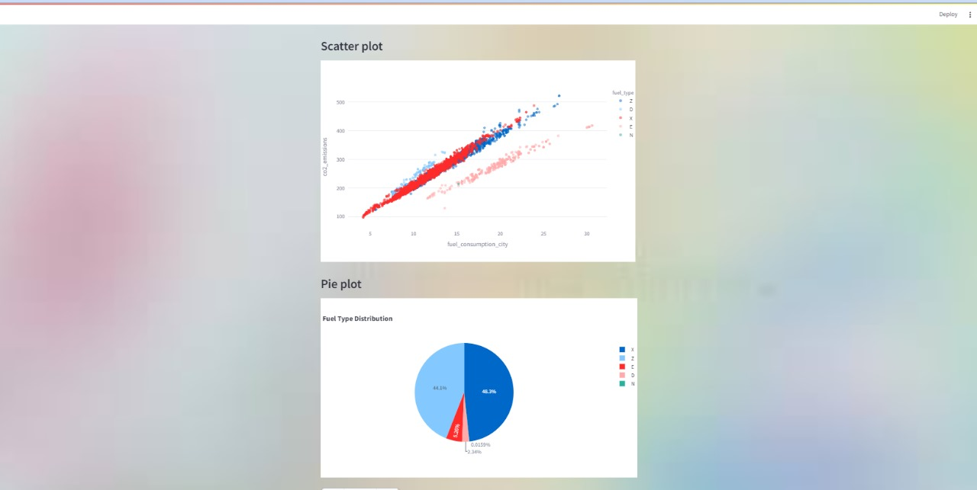
EDA Page

Slide 32
Home Page

Slide 33
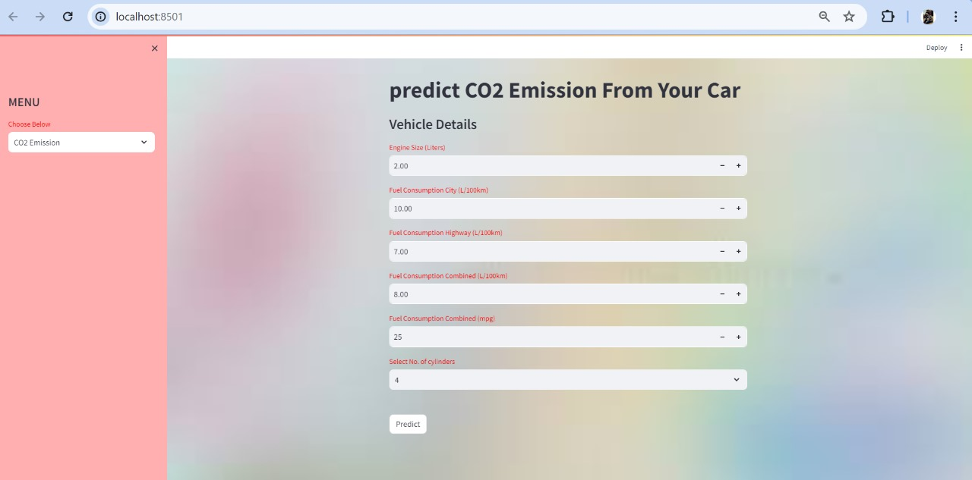
Prediction Input page

Slide 34
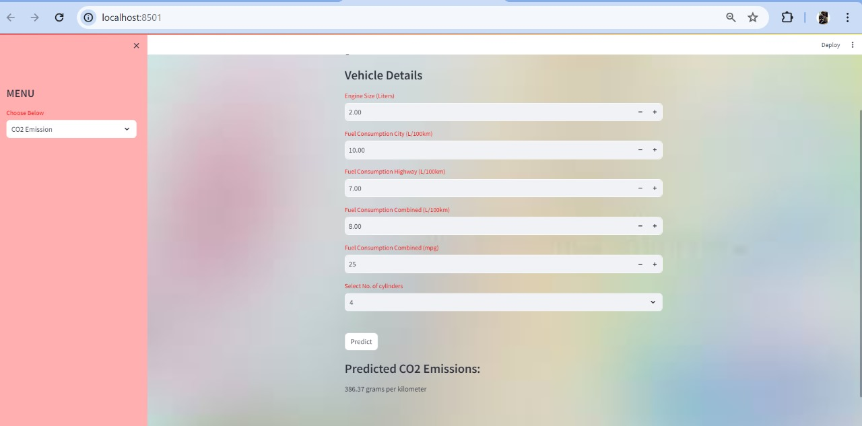
Prediction Input page with Output

Slide 35
Challenges faced in the project
Creating highly interactive and responsive visualizations that can handle large datasets without performance issues.
Coming up with the right metrics for model selection.
Utilizing Streamlit's built-in components for creating forms, visualizations, and layouts to simplify the development process.Streamlit’s ability to deploy on platforms like Streamlit Cloud can simplify the deployment process.
Use Streamlit’s st.form and st.form_submit_button to manage complex forms and their submissions.

Slide 36

Thank you

